Slide 1
Summer Term 23 Responsible Artificial Intelligence Lecture-7: Engineering Methods for Ethical AI Systems
Prof. Dr. Holger Giese (holger.giese@hpi.uni-potsdam.de)
Christian Medeiros Adriano (christian.adriano@hpi.de) - “Chris”
Christian Zöllner (christian.zoellner@hpi.de)
Matthias Barkowsky (matthias.barkowsky@hpi.de)

Slide 2
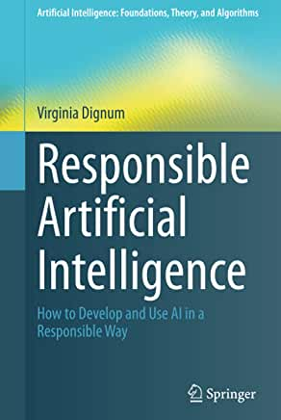
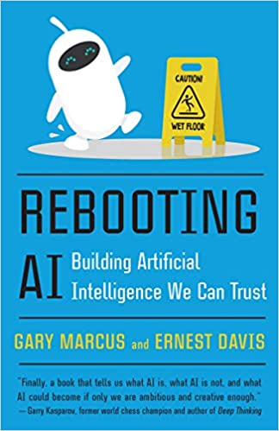

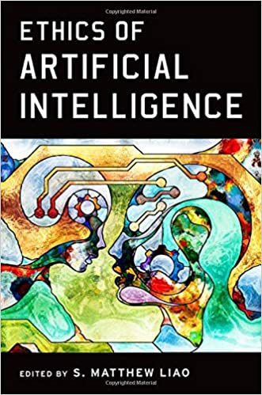
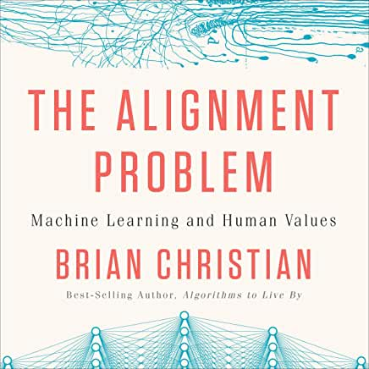
Sources (Books that we have been reading)
Armed Drones and the Ethics of War: Military Virtue in a Post-Heroic Age

Slide 3
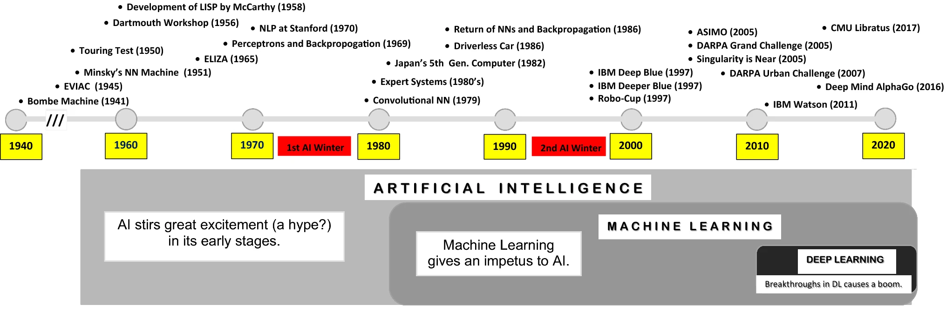
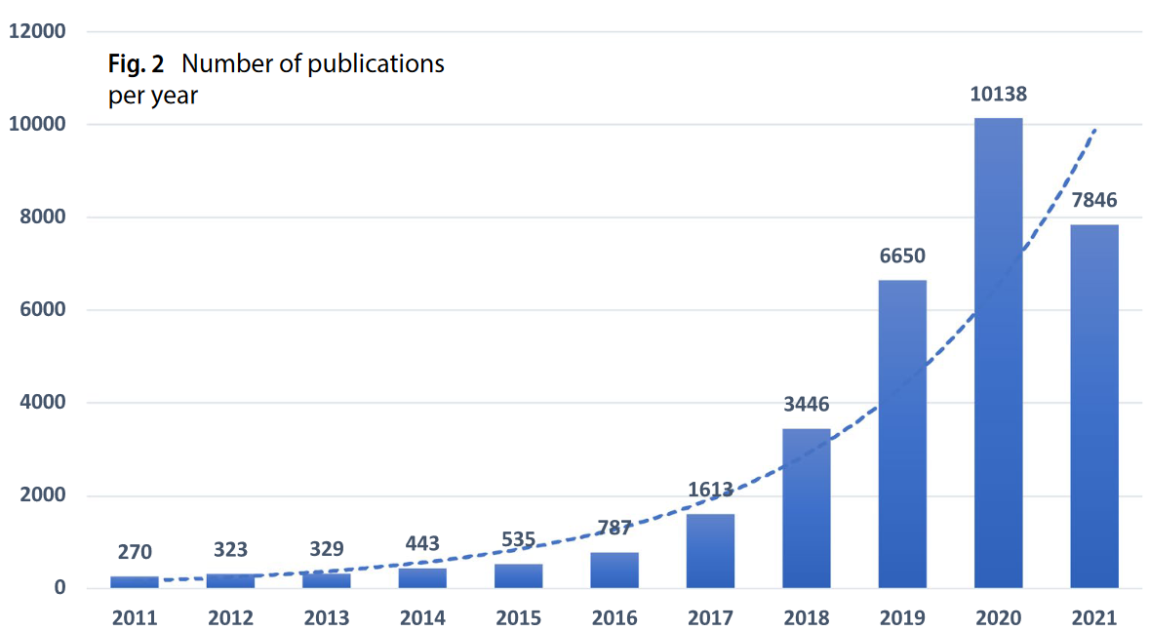
AI Timeline
source: Kaynak, O. (2021) The golden age of Artificial Intelligence. Discov Artif Intell 1, 1
NATO Conference [McIlroy 1968]
Exponential growth of publications after 2016

Slide 4
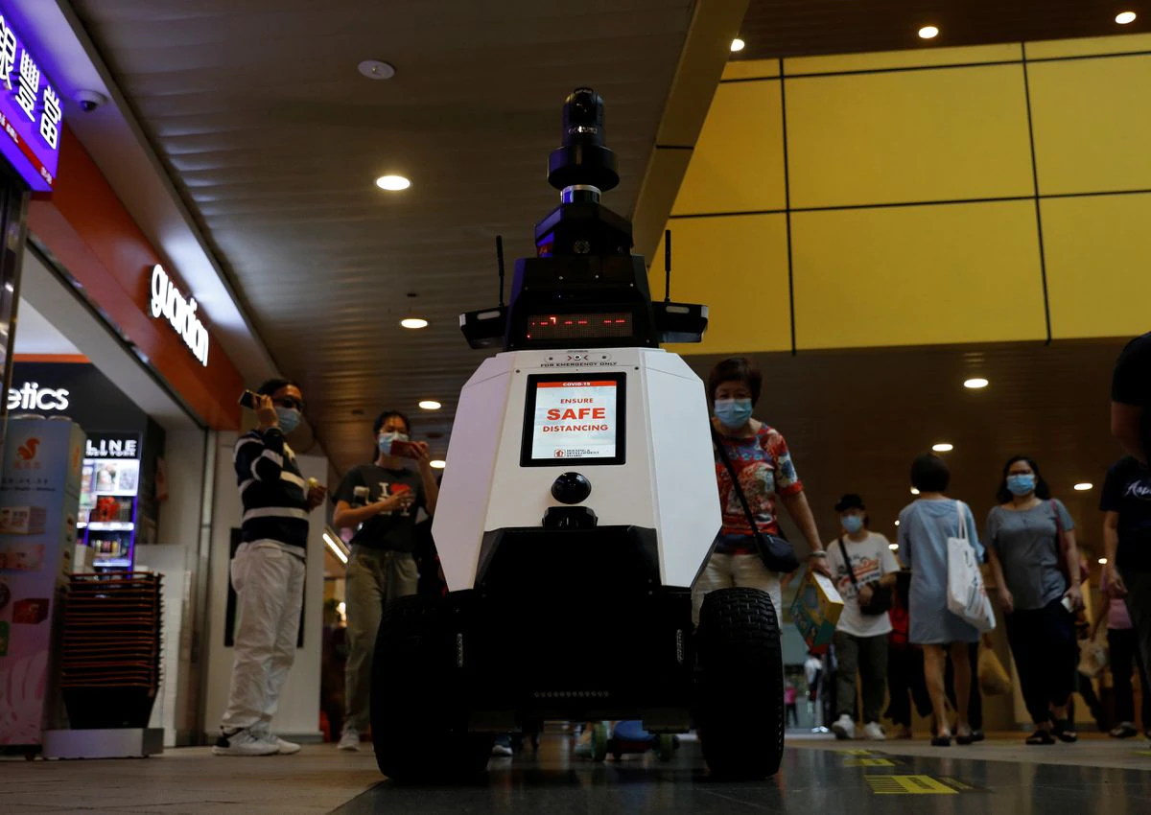
Surveillance and Military Technology
Singapore patrol robots to deter bad social behavior* [1]
White House proposes tech ‘bill of rights’ to limit AI harms, but Tech Industry pushes back in favor of self-regulation [2]
Cynthia Rudin became the second recipient of AAAI Squirrel AI Award for pioneering socially responsible AI.
“pioneering scientific work in the area of interpretable and transparent AI systems in real-world deployments, the advocacy for these features in highly sensitive areas such as social justice and medical diagnosis and serving as a role model for researchers and practitioners.” [3]
Xavier
*safety measures, smoking in prohibited areas and the improper parking of bicycles
[1] Reuters, 2021, https://www.reuters.com/technology/singapore-trials-patrol-robots-deter-bad-social-behaviour-2021-09-06/
[2] https://apnews.com/article/joe-biden-science-technology-business-biometrics-b9dbf5fee3bf0e407b988b31e21f5300
[3] https://ece.duke.edu/about/news/duke-professor-wins-1-million-artificial-intelligence-prize-new-nobel
Notes:
Singapore trials patrol robots to deter bad social behaviour [1]
is equipped with cameras that can detect bad social behaviour and trigger real-time alerts to the command and control centre.
Singapore also aims to double the number of cameras to have more than 200,000 police cameras by 2030.
US safety regulator opens investigation into Tesla Autopilot following crashes with parked emergency vehicles [2]
Most of the incidents took place after dark and occurred despite “scene control measures,” such as emergency vehicle lights, road cones and an illuminated arrow board signaling drivers to change lanes.
“The investigation will assess the technologies and methods used to monitor, assist, and enforce the driver’s engagement with the dynamic driving task during Autopilot operation,”
“commonsense safety measures,” like requiring the U.S. Department of Transportation to issue safety standards for ADAS. These standards were included in the House version of the infrastructure bill, but were stripped out of the version of the $1.2 trillion bill ultimately passed by the Senate on August 10.

Slide 5
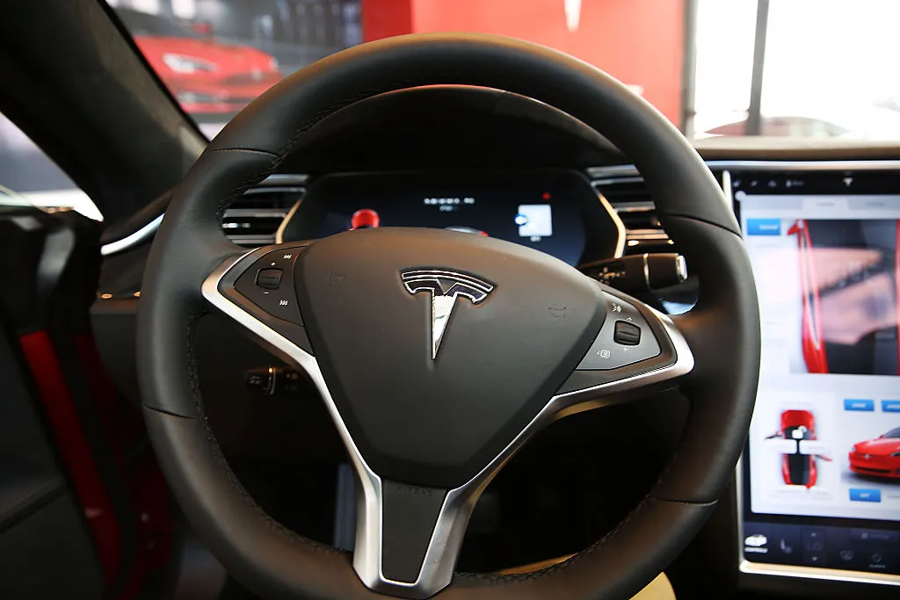
Self-Driving Technology
Tesla Auto-pilot under scrutiny**[1]
Number of distinct autonomous vehicles platforms deployed in the streets of California increased 6-fold, while the reported accidents increased 12-fold.
**advocates for Highway and Auto Safety are calling for “minimum performance standards” for vehicles equipped with Auto-Pilot System
Goal: How to increase trust on technology while increasing its complexity and autonomy without increasing the risk of accidents?
Approach: We [3] studied this problem from the perspective of reliability engineering in which a given risk of an accident has severity and probability of occurring.
[1] Techcrunch, 2021, https://techcrunch.com/2021/08/16/u-s-safety-regulator-opens-investigation-into-tesla-autopilot-following-crashes-with-parked-emergency-vehicles/
[2] Department of Motor Vehicles of the State of California, Testing of Autonomous Vehicles with a Driver. https://www.dmv.ca.gov/portal/dmv/detail/vr/autonomous/testing
[3] Haensel, J., Adriano, C. M., Dyck, J., & Giese, H., 2020, Collective risk minimization via a bayesian model for statistical software testing, SEAMS.
Notes:
Singapore trials patrol robots to deter bad social behaviour [1]
is equipped with cameras that can detect bad social behaviour and trigger real-time alerts to the command and control centre. Singapore also aims to double the number of cameras to have more than 200,000 police cameras by 2030.
US safety regulator opens investigation into Tesla Autopilot following crashes with parked emergency vehicles [2]
Most of the incidents took place after dark and occurred despite “scene control measures,” such as emergency vehicle lights, road cones and an illuminated arrow board signaling drivers to change lanes.
“The investigation will assess the technologies and methods used to monitor, assist, and enforce the driver’s engagement with the dynamic driving task during Autopilot operation,”
“commonsense safety measures,” like requiring the U.S. Department of Transportation to issue safety standards for ADAS. These standards were included in the House version of the infrastructure bill, but were stripped out of the version of the $1.2 trillion bill ultimately passed by the Senate on August 10.

Slide 6
Reengineering Complexity Simplicity -> Interpretable -> Causal -> Robust
Complexity, particularly accidental ones, tend to make systems brittle and obfuscated.
Conversely, simplicity tends to make systems more interpretable
Interpretability at the model level allows to identify possible about causal mechanisms
Causal mechanisms allow to plan interventions (perturbations)
Interventions allow to design perturbations to improve system robustness

Slide 7
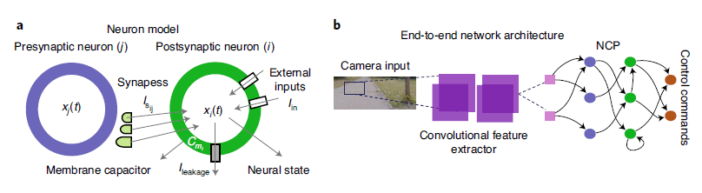
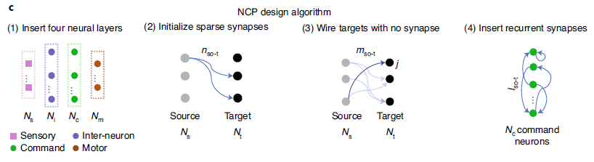
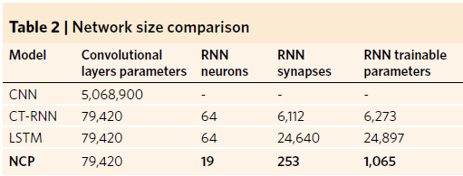
Biological Inspired Networks [Hassani 2020][Lechner 2020]
Limitation NN cannot adapt to data stream changes because fixed implicit non-linear architecture at training time.
Solution NN of linear first-order dynamical systems modulated via nonlinear interlinked gates. Allow dynamical systems with varying time-constants coupled to their hidden state, with outputs being computed by numerical differential equation solvers. Allow the parameters to change over time based on the results of a nested set of differential equations [Hassani 2020].
Control neurons, connecting 32 encapsulated input features to outputs by 253 synapses [Lechner 2020]
Notes:
[Hassani 2020]
[Lechner 2020]

Slide 8
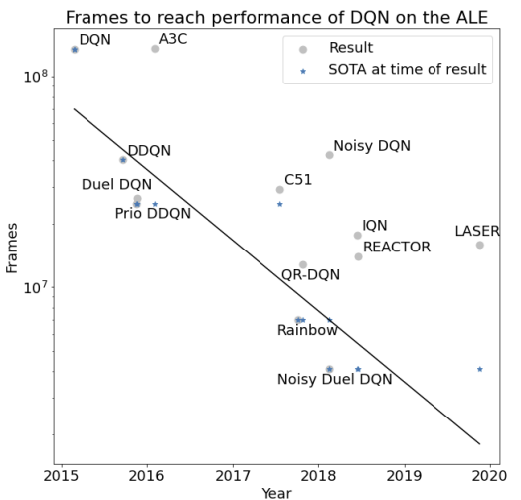
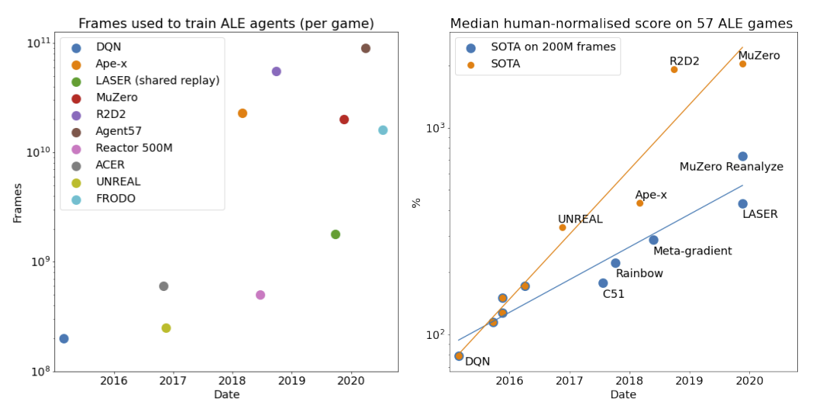
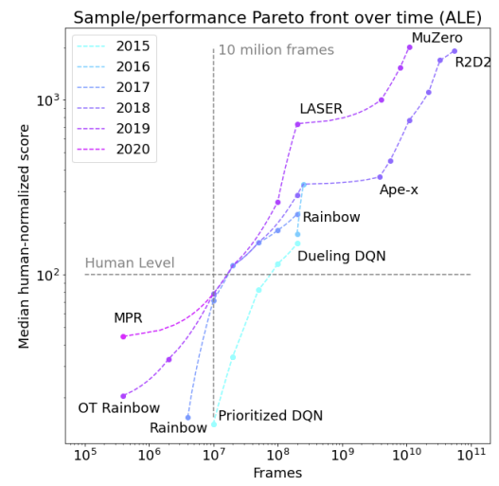
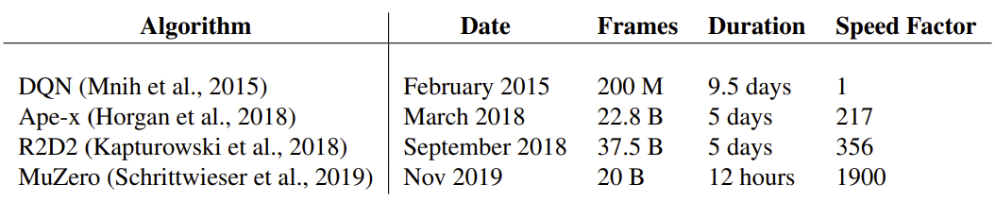
Reinforcement Learning [Dorner 2021] Dorner, F. E., 2021, Measuring Progress in Deep Reinforcement Learning Sample Efficiency
Speed factor = the speedup in the number of frames used per second compared to DQN, [Dorner 2021]
Deep RL algorithm innovations have been providing steady doubling of performance every 11 months.
How? Improvements on sample efficiency (samples and algorithm needs to perfume on a task).
Notes:
Dorner, F. E., 2021, Measuring Progress in Deep Reinforcement Learning Sample Efficiency, https://arxiv.org/pdf/2102.04881.pdf
https://www.lesswrong.com/posts/jYNT3Qihn2aAYaaPb/efficientzero-human-ale-sample-efficiency-w-muzero-self

Slide 9
EfficientZero – Model and MCTS-Based RL Ye, W., Liu, S., Kurutach, T., Abbeel, P., & Gao, Y. (2021). Mastering Atari Games with Limited Data.
190.4% mean human performance and 116.0% median performance on the Atari 100k benchmark
two hours of real-time game experience
Sample efficiency: Similar performance to DQN's at 200 million frames while we consume 500 times less data.
2021
Forecasts [AI-Impacts 2016]
- [Atari fifty] Outperform human novices on 50% of Atari games after only 20 minutes of training play time and no game specific knowledge.
- The original Atari playing deep Q-network outperforms professional game testers on 47% of games¹, but used hundreds of hours of play to train².
1 Mnih et al. (2015). Human-level control through deep reinforcement learning 2 Lake et al. (2015). Building Machines That Learn and Think Like People
[AI-Impacts 2016] https://aiimpacts.org/2016-expert-survey-on-progress-in-ai/#Narrow_tasks
EfficientZero
Notes:
How EfficientZero works?
- It learns the environment dynamics by self-supervision (instead of relying only on reward signals)
- For that the add a similarity loss to the loss function of MuZero that provides extra supervision for learning the dynamics, but gradients from rewards still reach the dynamics and representation networks.

Slide 10
What about Cyber-Physical Systems?
More complicated because CPS require more complicated reward-shaping work to obtain desired behavior.
In video games the reward is already computed and one just needs to finds a policy to maximize it.
Conversely, in CPS, the various tasks and subtasks have require a human to determine the reward.
Hard: “Desired Behavior -> Rewards for RL”
Easy: “Rewards for RL -> Desired Behavior“

Slide 11
The Problem Space (Challenges)

Slide 12
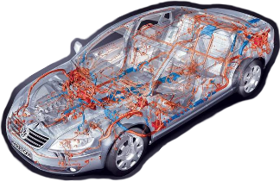
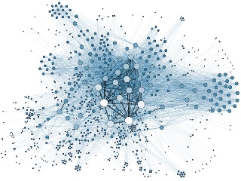
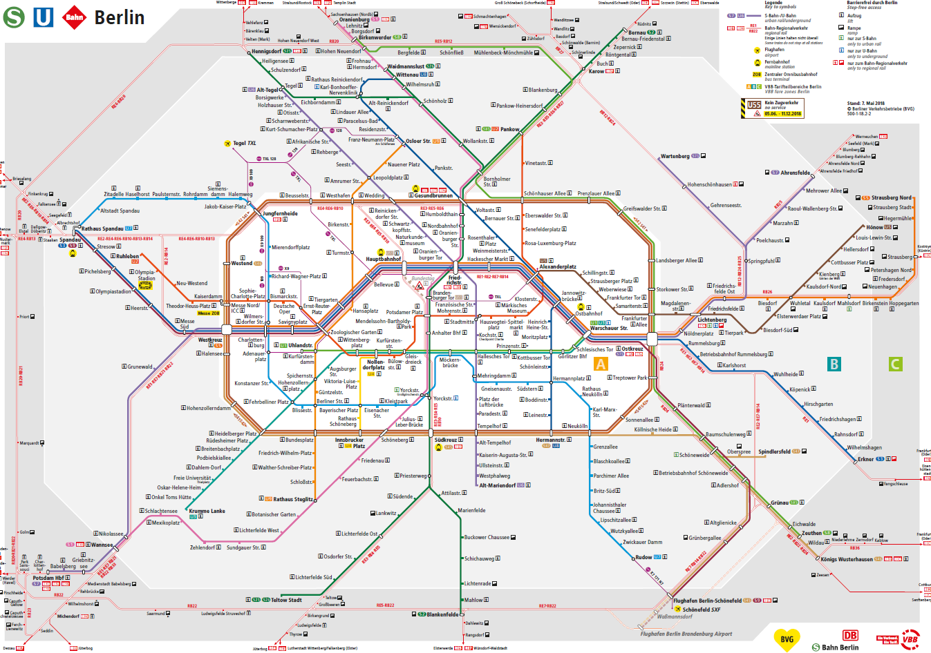
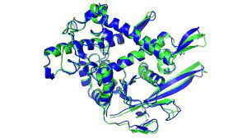

“All models are wrong, but some are useful” George Box, 1976
What?
Model
represents
Complex System
How? Abstraction + Pragmatism
Cyber-Physical
Systems
Systems of Systems
Why?
Usages
Understand complexity
Communicate, Design, Analyze, Document
Human Phenomena
Natural Phenomena
Mitigate complexity
Transform, Generate, Make Decisions, Control
Notes:
Well, “All models are wrong, but some are useful”. So, what is a model? A model represents a complex system, for instance, cyber-physical systems like a self-driving car, systems of systems like drones, human phenomena like urban traffic or natural ones like protein folding. How to represent a complex thing with a simple one? The magic is to combine Abstraction with Pragmatism. Abstraction removes all unnecessary details, while pragmatism keeps the details that matter. But matter for what? In other words, Why do we use models? Models can be used for many things. For instance, to understand complexity, for which we use techniques to Communicate, Design, Analyze, and Document. Based on that understanding, we can mitigate complexity, for which we need techniques to Transform, Generate, Make Decisions, and Control Systems, like intelligent systems

Slide 13
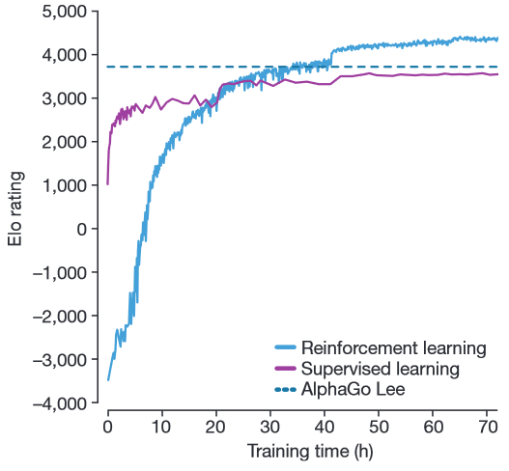
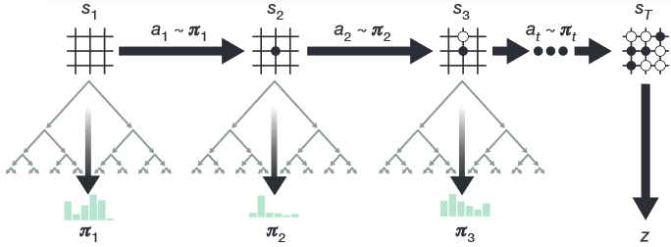
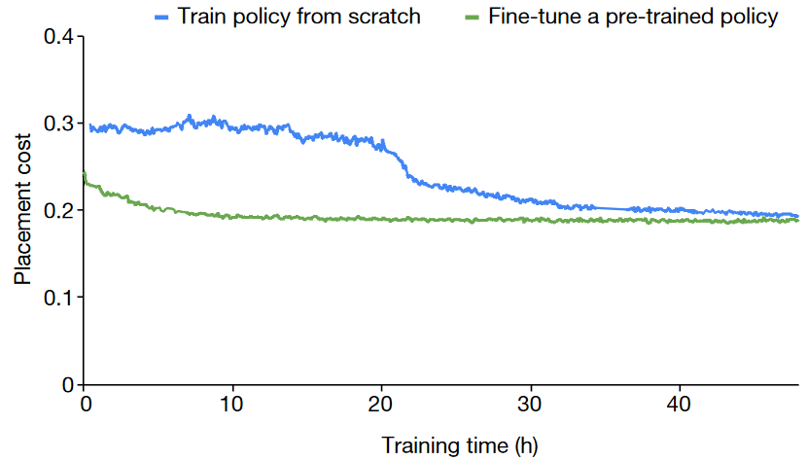
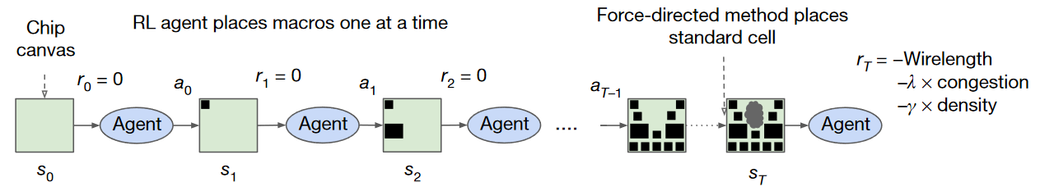
Progress of Techniques– Reinforcement Learning
Alpha Go-Zero learned to win without supervision, only by self-play [DeepMind 2017]
RL agent designed optimal layouts for TPU chip circuit [Google 2021]
Notes:
Let’s look deeper into the progress of these techniques, in particular reinforcement learning, where an intelligent agent makes decisions on how to learn a model of a complex environment as means to control it. Alpha Go-Zero learned to win the famous game of Go without supervision. Instead, it learned by playing against previous versions of itself. Besides that, as the blue and purple curves on the right show, the self-play approach achieved higher performance than the previous version of the Alpha-Go. If you recall, the one that defeated the world-champion Another recent progress. This year Google announced that a reinforcement learning agent was able to design optimal circuit layouts for its TensorFlow chip. A feat that was still beyond the capacity of automated tools.

Slide 14
Context: The Progress of Multi-Agent Reinforcement Learning
AlphaStar was rated at Grandmaster level for all three StarCraft races and above 99.8% of officially ranked human players [Deepmind 2019]
Three pools of agents, each initialized by supervised learning, were subsequently trained with reinforcement learning. As they trained, the agents intermittently added copies of themselves and played against previous version.
[DeepMind 2019] “Grandmaster level in StarCraft II using multi-agent reinforcement learning”. Nature 57
OpenAI Five became the first AI system to defeat the world champions at a sports game [OpenAI 2019]
Self-play RL can achieve superhuman performance on a challenging multi-agent task, e.g., extremely long-temporal dependencies.
[OpenAI 2019] "Dota 2 with large scale deep reinforcement learning." arXiv:1912.06680.
Notes:
Let's start with some context on the progress of multi-agent reinforcement learning. AlphaStar was rated at Grandmaster level for all three StarCraft races and above 99.8% of the officially ranked human players. Three pools of agents, each initialized by supervised learning, were then subsequently trained with reinforcement learning. The magic here was that during training, these agents added copies of themselves and played against previous versions. In another recent progress, OpenAI Five became the first AI system to defeat world champions at a sports game. They also relied on self-play to achieve super-human performance on a challenging multi-agent task with long temporal dependencies.

Slide 15
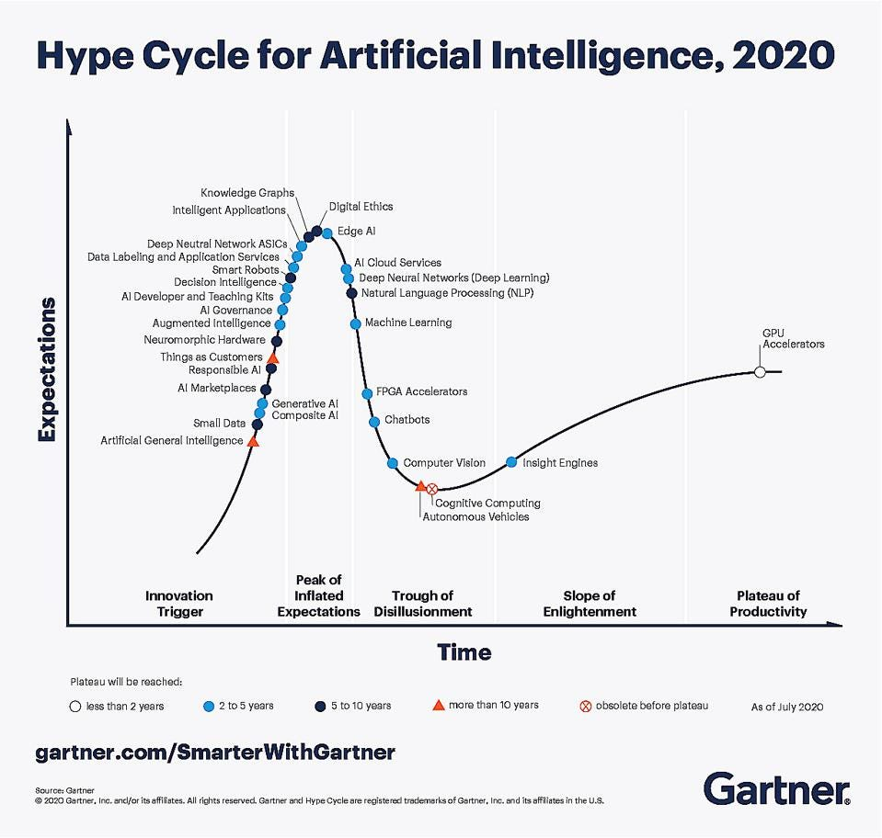
However AI systems are not being deployed
55% of companies surveyed haven't deployed a machine learning model [Algorithmia 2020]
72% that began AI pilots before 2019 haven’t deployed a single system yet [Capgemini 2020]
Why? Current models cannot adapt to more complex and evolving realities - adversarial environment
[Gartner 2020]
Problem? Lack of Robustness in AI Systems
[Jordan 2019], [D’Amour et al. 2020]
Notes:
-However, industry surveys report that from 55 to 72% of companies are not being able to deploy AI systems.
-Why? Because these systems cannot adapt to more complex and evolving realities, in other words, adversarial environments.
-The inability to adapt is a problem of lack of robustness in these AI Systems.

Slide 16
The Nature of the Problem Structure vs Frequency
Degree of structure
Physical laws
traffic
protein folding
circuit design
1
Artificial laws
games
simulators
software systems
2
Strong
(well-constrained)
[Google 2021]
[DeepMind 2017]
4
Human laws
human-in-the loop
image & text interfaces
3
Adversarial laws
distribution shifts
concept drifts
latent factors
Medium
(under-specified)
[!]
[Gao et al. 2021]
Sparse
(causal associations)
High
(accidental associations)
Frequency of events
Notes:
Before we search for solutions, let’s try to understand the nature of this problem. It has two dimensions: how structured the laws are, for instance, well-constrained as in quadrants 1 and 2, which correspond to the physical laws as in traffic and the artificial laws as in games. The second dimension is the frequency of the events, like high frequency as in quadrants 2 and 3 or sparse as in 1 and 4. *Many solutions cover quadrants 1, 2, and 3. However, quadrant 4 is under-explored, because adversarial laws are much more challenging. That’s why in the last years, our group has been exploring exactly the quadrant 4.

Slide 17
The Design Space (Solutions)

Slide 18
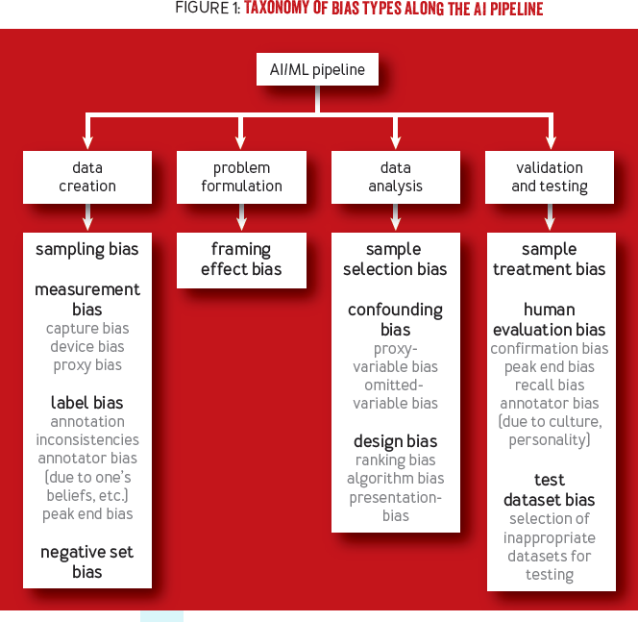
Taxonomy of Biases
There are many reasons for an engineer to have a wrong model of the world (figure-1)
These biases also impact users in very diverse ways.
I am more interested on bias sample selection bias and confounding bias (under the data analysis)
Before we delve into these bias, we need to answer the question, why many times simply getting more data does not solve the bias problem?
The Reason: the bias-variance trade-off
[Srinivasan & Chander 2021]
Notes:
[Srinivasan & Chander 2021]
]Biases in AI Systems
https://queue.acm.org/detail.cfm?id=3466134

Slide 19
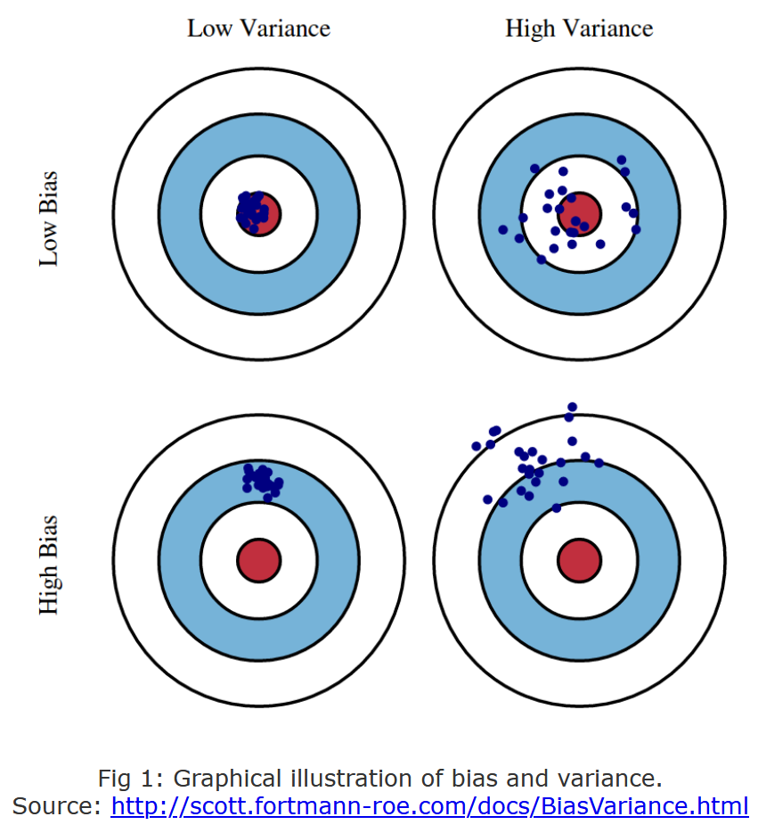
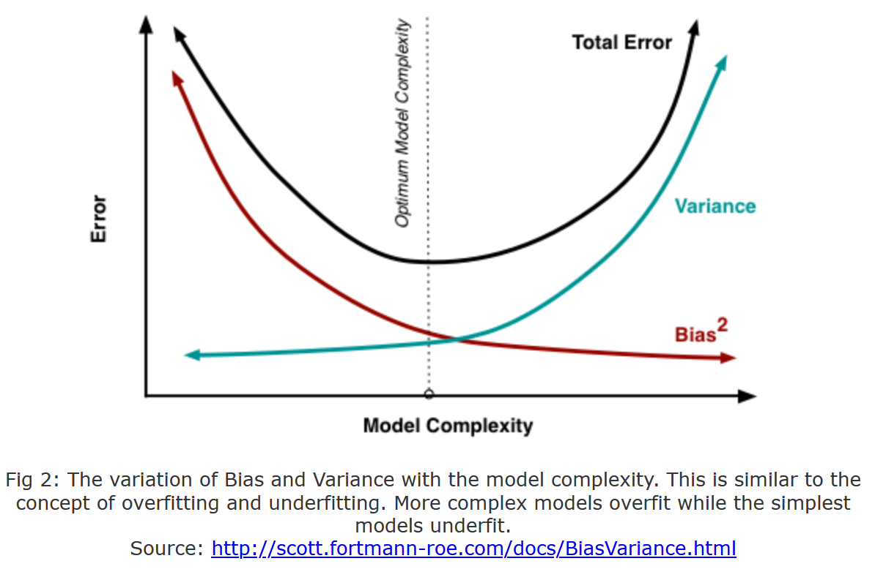
How do we currently think about robustness? -> Bias-Variance Trade-off

Slide 20
Implications to predictive models
Goal: Generalize data associations as predictive patterns
Assumptions: good data and observable patterns
Reality: sparse data and hidden states
Sparse data (Essential limitation, cannot eliminate with better prediction models)
Latent patterns (Accidental, can eliminate with better models)
Source – Misspecification
Not enough data or bad tunning of a model can make the concept drift more severe, as models might present strong bias (insensitive to crucial features) or high variance (too sensitive to noise).
Under-specification (leads to bias-underfitting)
Over-specification (leads to variance-overfitting)
Notes:
Model choice: wrong choice is accidental if not well-informed
Model generation: wrong if not well-informed
However, if after being informed with the best of our knowledge, choice and generation can still be affected by inherent difficulties posed by the essence of ml-based predictive models: Sparse data and Latent states. This means that better models can never eliminate the effects of sparsity and latency.
Nonetheless, it can still mitigate, reduce either their effects in terms of impact (magnitude) or their probability (over multiple training procedures).
Sparsity can be mitigated with models that allow to incorporate and update prior-knowledge, e.g., Bayesian methods, transfer learning methods.

Slide 21
Adversarial Changes in the Environment Sources of Sparsity and Unobservability
Changes in the Data Generation Process:
Covariate Shift (change in data distribution)
Domain Shift (change in the action-state space)
Concept Drift (change in the associations)
These changes are independent of the model, but the model might make the problem worse.
Goal: A robust model should have structures and conditions in place to mitigate the effect of these changes on the performance of the model.
Plausible Changes -> Sparsity + Observability -> Model performance

Slide 22
Mitigation of Ethical Failures / Dilemmas Data-Centric vs Systems-Centric
Data-Centric: Which data problems (data privacy violations, biases, etc.) are ethical dilemmas or failures in machine learning models? Mitigation might involve, pre-process data, obtain better data, augment data, or use more robust statistical methods (e.g., less prone to overfitting).
Systems-Centric: Which levels of autonomy contribute to ameliorate or degrade the ability of a system to handle ethical dilemmas?
Design Aspects - feedback loops, cross-cutting concerns (monitoring, exception handling, failure propagation), decision-making mechanisms (agents, controllers), and the corresponding actuators.
General Goal - How AI-Systems can self-adapt to cope with adversarial changes in the environment that impose ethical failures / dilemmas
Example: to redesign an avionics system to comply to a more appropriate set of ethical requirements one needs to go beyond better prediction models. One needs to understand which aspects of the system contribute to ethical failures and how these can be mitigated. Noting that mitigation actions might involve new ethical choices.

Slide 23
Adversarial Fragilities Online (Continual) Learning
Hidden confounders + Selection Bias
Simpson’s and Berkson’s paradoxes
Shortcut learning in Neural Nets
This goes beyond overfitting, as it cannot be solved with more or better data!
Underspecified Models
Unsafe state-action Spaces
Non-IID and OOD Data
Wrong predictions can spur unsafe actions that can lead to unsafe states.
Sensitivity analysis and testing on hold-out-sets are ad hoc approaches cannot guarantee safety.
“Program testing can be used to show the presence of bugs, but never to show their absence!” ― Edsger W. Dijkstra
Real-world is non-stationary
Predictions affects the data generation process
Modeling better recommender systems is not enough, because uncertainty grows wildly when extrapolating out-of-distribution
Notes:
“Program testing can be used to show the presence of bugs, but never to show their absence!” ― Edsger W. Dijkstra

Slide 24
Adversarial Fragilities - Solutions Online (Continual) Learning
Pre-trained models:
Optimal Bias-Trade-off for fine-tuning
Rashamon sets
Domain-Adaptation
Invariant Representations
Underspecified Models
Unsafe state-action spaces
Non-IID and OOD Data
Generative models of OOD
Sampling-based (importance sampling)
Feature-based (new task)
Intervention-based (control)
Safe learning in production:
Specify safety (domain-knowledge, Constrained MDP, Shielding)
Learn to be safe (sandbox/digital-twin)
Notes:
Operational envelope (engineering idea) for safe/robust learning (% of safety violation guarantee)
Business critical systems
Critical State Spaces
Envelope has to be evolved as well
How to know that the envelope is valid.
Lecture on Safety&Resilient Systems – structures that adjust (reviewing safety margins)
Accidents trigger reviews of safety margins
Human-on-the-loop (confirm the automated decision)
Recommendation system – how many are accepted vs rejected
Imitation learning vs Reward modeling
Crash example (how many people were affected), not possible, because measurements are also missing in a crash (income loss, satisfaction loss), e.g. Counterfactuals. These are phenomena that the runtime model can estimate indirectly (failed transactions)

Slide 25
Connections between Fairness and Robustness
Zhang, B. H., Lemoine, B., & Mitchell, M. (2018). Mitigating unwanted biases with adversarial learning. In Proceedings of the 2018 AAAI/ACM Conference on AI, Ethics, and Society (pp. 335-340).
Kilbertus, N., Rojas-Carulla, M., Parascandolo, G., Hardt, M., Janzing, D., & Schölkopf, B. (2017). Avoiding discrimination through causal reasoning. arXiv preprint arXiv:1706.02744.
Suggested questions
How do failures in satisfying fairness requirements lead to lack of robustness?
What type of robustness engineering methods can be used to reify fairness requirements?
How fairness can be achieved by means of Learning to be Safe, Fail-Safe Resilient, Recoverable mechanisms?
?

Slide 26
Warm-up task: Start thinking about the use cases of your project
Choose a set of users (e.g., doctor, patient, engineer, operator, analysist)
List possible use cases (functionalities that would satisfy these users)
Give examples of existing systems that implement these use cases (provide references)
For each use case, describe briefly (~4 lines) the risks involved
Share it on Slack by Friday Evening – May 26 (channel #writting)

